Slide 1

Media Briefing on The petroleum and liquid fuels industry charter (LFC) AUDIT REPORT 5 July 2012
Presenter: Ms Gosetseone leketi

Slide 2

Presentation Outline
1. Introduction
2. Findings by element
2.1. Ownership
2.2. Management control
2.3. Capacity Building
2.4. Employment Equity and Supportive Culture
2.5. Procurement
2.6. Access to Facilities and Wholesaling
2.7. Retailing
3. Results summary
3.1. Summary comparison: LFC vs. BEE
3.2 Conclusions and Impact Analysis
4. Recommendations
4.1. Ownership, Management Control, Supportive Culture and Employment Equity
4.2. Capacity Building, Procurement, Access and Wholesaling
4.3 Refining, Retailing, Access to Finance, Reporting and M+E and Sector Code

Slide 3
Introduction
Objectives of the Assessment
To assess compliance to the LFC by the signatories &
related progress towards transformation of the industry
Audit Interviewees
BEE Consortium Leaders,
Chairpersons, Black Directors, CEOs,
Divisional Heads, Staff,
HDSA Suppliers, Retailers, Wholesalers
LFC Charter Elements
Ownership, Management Control, Supportive
Culture, Capacity Building, Employment Equity,
Private Sector Procurement & Terms of Credit,
Access to Joint Facilities, Refining Capacity, Retailing,
Wholesaling, financing and Synfuel Supply.
Submission Quality
The quality ranged from an estimated 55% to about 90% per company
3 categories of results
Strict LFC Audit results
BEE results summary
Additional statistics & findings on key employment issues & known BEE gaps
Performance vs. compliance level
It is possible to be compliant even if performance is very low and vice versa .
i.e. have high level of performance but not be compliant as specified mark not attained.
The LFC and the BBBEE codes
Have notable synergies: Both have the same objective; the advancement of HDSA’s.
LFC Weaknesses
The LFC thus lacks the following as compared to the BBBEE framework:
Weights (not clear which requirements carry more weight and priority).
Targets (no clear compliance targets for all elements except Ownership and Management Control).
Categories / indicators (no measurable indicators for some elements, e.g. on EE).
Broad Base (the LFC is biased towards ownership and enterprise development).
However the LFC has a number of key requirements not accommodated in the Codes, e.g.: Crude procurement, & Specific ED initiatives.

Slide 4
Ownership
Ownership LFC Results |  |  |  | Ownership additional (BEE) Results |  |  |  |  |  | Compliance status
Economic Interest | Voting Rights | Sustainability | All Value Chain Segments | Voting Rights of Black Women | Economic Interest Black Women | Black Designated Groups | Ownership Fulfillment | Net Value | New Entrants Value | Compliance Level
18.91% | 18.29% | 90% | 100% | 7.31% | 6.72% | 6.09% | 0% | 12.74% | 5.94% | 50%
Other Observations
It is the second – highest scoring LFC element.
The average effective black shareholding is 18.91% of the 25% target
Black women representation is 6.72%.
None of the black shareholders have fully fulfilled obligations of ownership except for one Oil company.
Most of the black women ownership is as trust beneficiaries or junior consortium partners
i.e. there is no attendant participation as shareholders.
White women largely excluded from all deals.
So far only a trickle dividend received by most.
Most of the black shareholders are passive, serial investors than active entrepreneurs
Most of the deals are relatively clean - with no contentious clauses and Black shareholders experience owing partly to B-BBEE reviews over the past few years.
Voting pool arrangements sometimes cause tension among black shareholders.
Some errors/alternative interpretations on some BEE certificates point to complexity
Impasse in all the problematic deals until review. .

Slide 5
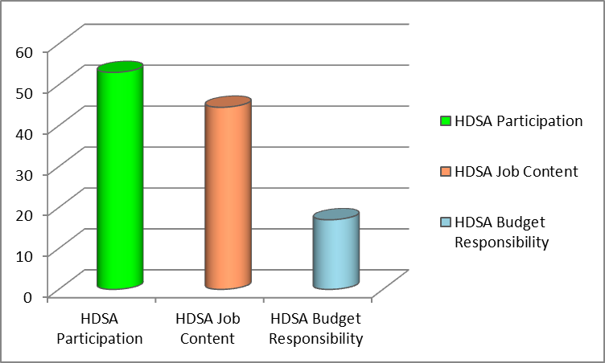
Management Control
Directors & Executives by Race & Gender
Contrasting HDSA responsibility Levels
RACE |  |  |  |  |  |  | GENDER
Category | Black | Coloured | Indian | Total HDSAs | White foreign | Total | Male | Female | Total
Directors | 51.5% | 3.0% | 4.57 | 59.1% | 40.9% | 100% | 73% | 27% | 100%
Executives | 32% | 13% | 8% | 53% | 47% | 100% | 78% | 22% | 100%
The Participation, Job Content and Budget Responsibility levels of the HDSA’s and depicting the imbalance:
EXECUTIVE DIRECTORS |  |  | NON-EXECUTIVE DIRECTORS |  |  | INDEPENDENT DIRECTORS
Total Overall | Total HDSA | Total White | Total Overall | Total HDSA | Total White | Total Overall | Total HDSA | Total White
31% | 14% | 17% | 64% | 40% | 24% | 5% | 5% | 0
Compliance is very high. This is the highest scoring element in terms of both the LFC and BEE.
Mostly white males and foreign nationals occupy strategic and senior positions as key decision makers.
Highest population of HDSA’s is in Human Resource, Strategy & Procurement (excl. crude)
Highest population of whites /foreign nationals is in Refinery Management, Finance & Planning
Expectation gap regarding black directors:
They are mainly non executives; fewer executives and independents.
Influence is also curtailed by multinational leadership structures
For some the monitoring of progress on transformation is seemingly not a key focus area or priority.
They are more concerned with securing own business interests.
The rotation of foreign national CEOs sometimes results in loss of transformation momentum.
Chevron and Total hardly had black people at the executive level and very few at senior management level.
5

Slide 6
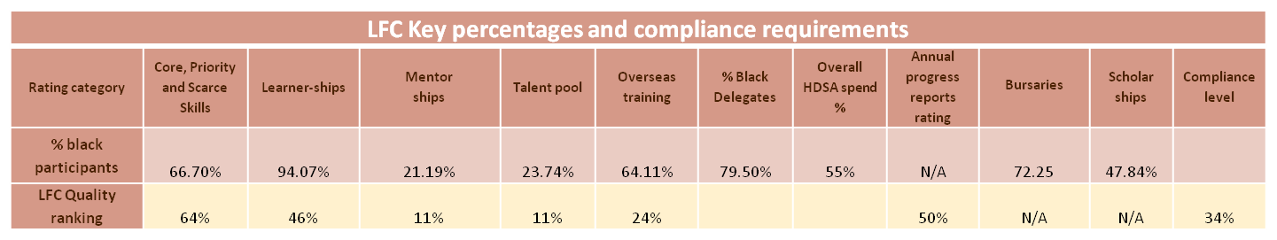
Capacity Building
NB: High percentage spend on HDSAs does not equal high quality performance.
Capacity Building Interventions
Core, Priority and Scarce skills training is in? Health, Safety and Environment, Risk Management, Petrochemicals, Planning and Marketing courses.
Learner-ships include Welding, Boiler Making, Mechanical Fitting, National certificate in Professional Driving.
The Internships include among others, Process Engineering, Chemical and Mechanical Engineering.
Most Bursaries are in Project Management, Mechanical Engineering and Chemical Engineering.
Most HDSA’s are not in the core scarce fields (Upstream Manufacturing, Supply and Trading).
But in the non-core scarce skills, like Project Management, Finance, HR.
Most interventions dominated by HDSA’s, both genders except for overseas training which indicates more males.
This was the second worst performing element due mainly to lack of mentorship programs, overseas exposure, talent pool identification and fast –tracking & effectiveness reviews.
Overseas training mostly entails attendance of conferences and short courses with very little operational exposure over a length of time.
Little evidence of fast tracking particularly of HDSA’s in most companies.
Also most companies did not have formalized mentorship programs for proper skills transfer.
It is the worst performing element under the BBBEE framework, largely due to the lack of work-based exposure and assessed programmes.
Some progress made, on certain capacity building initiatives, in particular, bursaries, scholarships, (some) learnerships and internships.
However training on artisan skills required for refurbishments, renovations and expansion of refineries and other facilities as well as for other strategic projects is lacking.
Another opportunity loss was the acquisition of trading knowledge and expertise by HDSA’s, as the function has been relocated and is now mainly performed through overseas operations.
Average spend on HDSAs has decreased from 71% to 55% since 2006. The actual rand amount expenditure also decreased during this time.
6

Slide 7
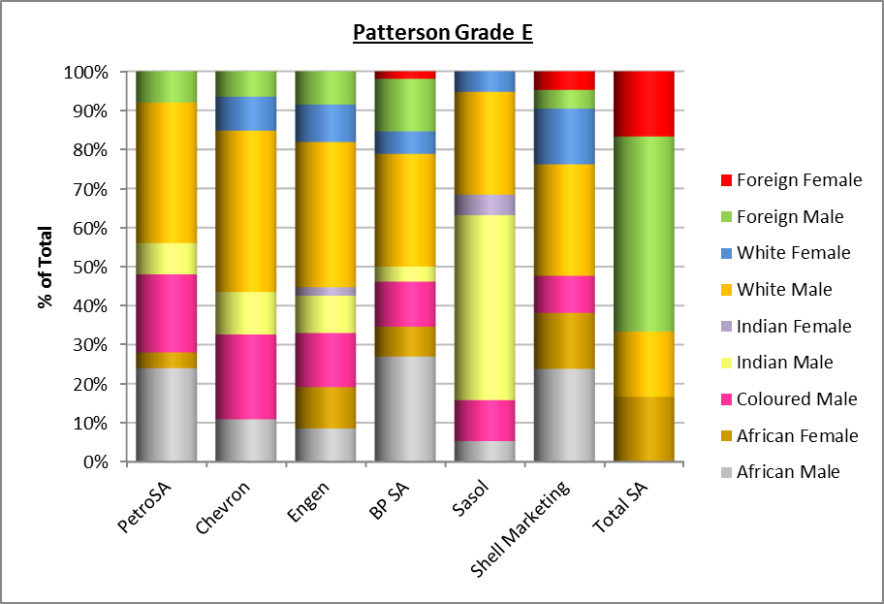
Employment Equity and Supportive Culture
Employment Equity Performance Results |  |  |  |  | Employment Equity Compliance Status
% HDSA (ABCDE) | % HDSA (EDC) | E Band | Equitable Job Content | Equitable Budget | Publishing of equity stretch targets and achievements | Meeting of equity targets | Job content of HDSAs vs.non-HDSAs | Inclusiveness of gender | Average compliance status of the industry
74.3% | 71.2% | 50.4% | 44% | 17% | 57% | 17% | 49% | 30% | 38%
Supportive Culture Performance / Compliance Status
Main Coordinator Seniority | Board Level Transformation Committee | Appropriate Managers | Fostering Supportive Culture | Appropriate Policies | Compliance Level
Middle manager | No | 51% | 44% | 49% | 49%
Supportive Culture Observations
Lack of awareness of the LFC within the companies, even at senior level.
A relatively high turnover of blacks, because of frustration
Perception that blacks are set up for failure as the culture not supportive.
Most line managers seen as the major stumbling blocks.
The dedicated managers’ seniority level has been lowered over time:
From executive director level to middle manager level.
Suggesting a view that this function is now viewed as superfluous.
Yet input from HDSA staff, suppliers & customers suggests
otherwise.
The function in most of the companies is performed by HDSA managers.
Implementation is driven from HR instead of line functions for buy-in.
The positions represented in the teams are from HR, BEE Strategy, External Affairs, Procurement. One company has included Retail Management.
Employment Equity Observations
This is the third lowest scoring element.
Fair progress in respect of black representation overall.
However, women representation is still too low especially on the higher levels.
Skewed representation of Indian professionals in management levels of 1 company & to lesser extent 2 others.
Black representation in all the management levels is below the EAP target of 87.5%

Slide 8
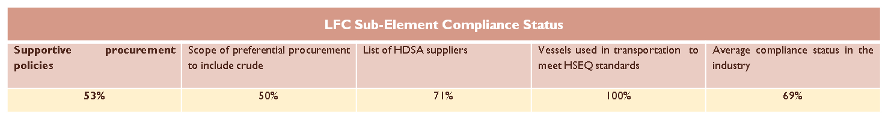
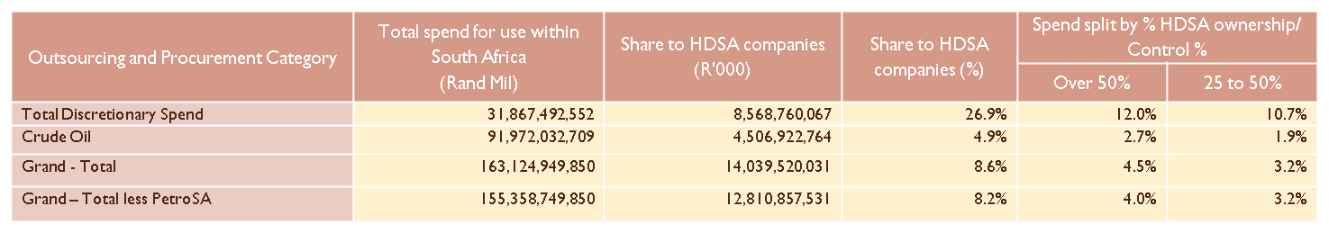
Procurement
Spend analysis from >50% HDSA companies
Expenditure of at least 25% - Civil and Maintenance, Transport and Service Industries.
Expenditure of below 5% - Packaging, Crude Oil, Telecommunication, Natural Gas, Other Capex, Additives, finance & Insurance and Coal.
Procurement from HDSAs is less than 5% for about 50% of the product lines.
Only 3 of the 6 oil companies comply with this element, the main differentiator being Crude.
The third company’s last purchase was however, in 2009.
Most Crude and other imports procurement and supply is controlled by international parent companies.
The challenge of buying crude from local traders is that they do not really trade but are brokers / facilitators.
It is thus generally more expensive to buy from them.
The support to and from SASDA has not worked according to plan for various reasons.
Among others the casualty of this is an industry – wide HDSA Supplier database.
Supplier development efforts are also sparse, unstructured and seemingly not effective.
No visibility of technically qualified & competent suppliers
including black owned and black women owned enterprises
for among others construction projects in forecourt, and mechanical, engineering, civil and processing jobs.
Some HDSA suppliers fail Health and Safety requirements.
Lack of development finance.
8

Slide 9
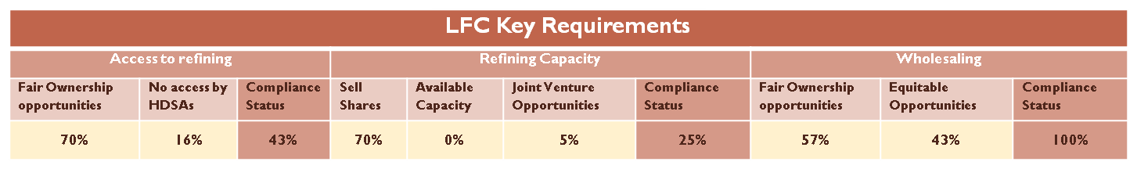
Access to Joint Infrastructure & Wholesaling
Other Access to Joint Facilities Observations
(No regulatory enforcement / refinement)
Non adherence to own regulations / act by NERSA worsens problem.
Licensees to provide information on uncommitted capacity
Lodgments of allocation mechanism for uncommitted capacity within 6 months of license
Annual submissions on commercial arrangements for the participation of HDSA’s
NERSA must use such information to facilitate ownership, control or management of operations of petroleum pipelines, storage facilities and landing facilities
No access to Transnet pipeline to move product from coast to inland
Transnet not aggressively employing empowerment legislation / policies
A lot of facilities( especially inland storage and distribution deposits ) were closed down without availing them to HDSA’s
As outside NERSA’s control
Competition Act lately cited as reason to withhold information
Minimal recent efforts in remote areas
Too much uncertainty on modus operandi & applicable policies
Concurrent legislation – LFC / BEE / PPPFA / Ports Act / PPA / PPAA
Compliance with one could mean breach with another
Other Wholesaling Observations
Negative competitive position
Challenge of competing with oil major trading divisions on price for spot crude.
Have to comply with more stringent license conditions
HDSAs cannot vertically integrate. Oil majors already vertically integrated
Allegations of illegal operators
More expensive credit
Too many HDSA wholesalers???
Perception that too many wholesalers acquire licenses’ without the requisite knowledge
The pie is too small to share. Need to enable current HDSA wholesalers businesses to grow?
A strategy by one company is to cap the number of HDSA’s used so as to accelerate their growth.
Ineffective / insufficient support
Least supported group is importing wholesalers
A few of the oil companies offer discounts or premiums
Experience of some is that the relationship with so called supportive oil companies
is only good on paper.
Only 3 oil majors buy crude from HDSAs
We could not confirm wholesale volumes & related percentages because of information dearth
Oil major challenges
Cash flow constraints
Insufficient commitment
No benefit / incentive and more expensive
9

Slide 10
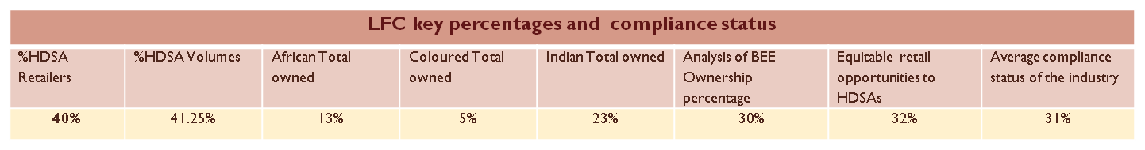
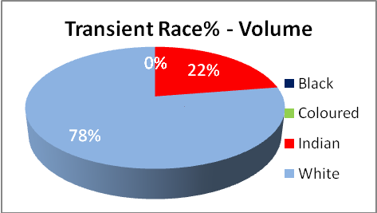
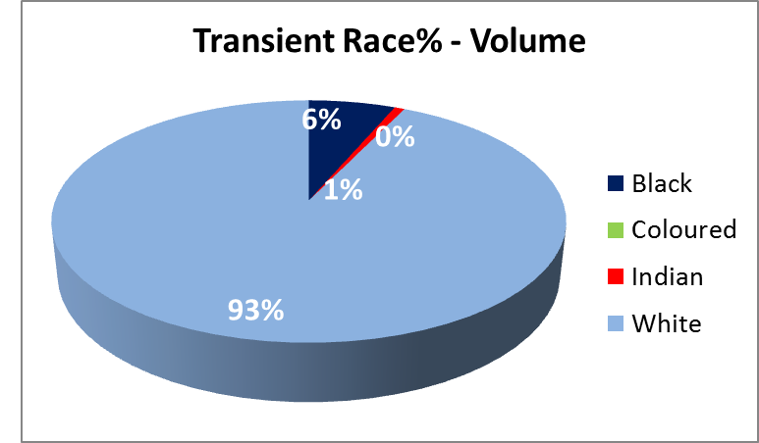
Retailing(Exc. Shell and Sasol oil)
Dealer Owned
Company Owned
Status Quo
Indians do better in volumes than other black groups
The Ownership of and volumes pumped by Whites outnumber those of the HDSA’s collectively.
White dealers pump 3 x more than Indians
who are 2nd in dominance.
There is still a challenge of ensuring equitable site allocation to HDSA’s for various reasons, including limited site availability.
Oil company challenges
Some old evergreen agreements with white retailers, property owners and developers.
Especially with respect to the more lucrative opportunities e.g. transient sites.
HDSA Retailer challenges/needs
Lack of Capacity to negotiate and manage contracts
e.g. the structure of royalties and rental payments
And the treatment of unreliable product suppliers.
Regulatory process anomalies and turn-around times.
Goodwill is not regulated, therefore the seller is at liberty to charge any price.
Entrepreneurship and business skills are not provided in the initial training
The modus operandi for stock items is not friendly towards local small businesses
10

Slide 11
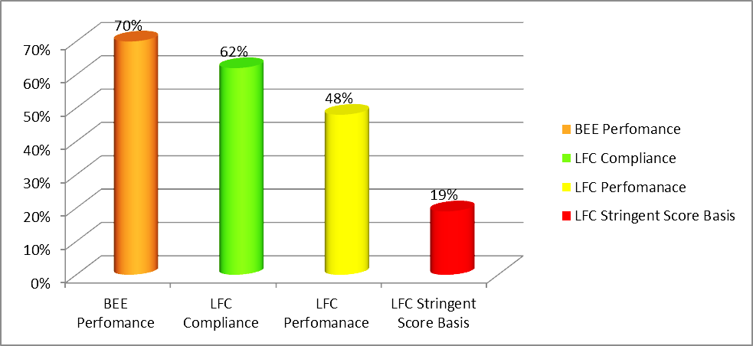
Results Summary
Stringent Basis:
Average 19% rate of full compliance; = “Yes” responses.
Performance Levels:
The average performance rate is 48% .
Compliance Levels:
The compliance rate is 62%; = All “Low to Yes” performance levels
= The converse of “No” and ’’Unknown” answers.
On average 3.5 out of 7 companies (50%) complied with each element.
BBBEE performance rate = 70%.
The performance rate gap between the 2 frameworks is thus 22% (70-48).
The oil companies scored as follows under BEE:
2 level 3's, 4 level 4's & 1 level 6
Progress since 2006
All the indicators showed improvement, due to the large time gap. There are however, decreases, all of concern, viz: (%decrease)
Supportive Culture: Full time exec director - 43 – 0 %( 100%)
Capacity Building: Total HDSA skills spend - 71% - 55% (22.5%)
Capacity Building: Learnerships: From 96% - 94.07% (2.01%)
Employment Equity: Semi & unskilled blacks 95% - 82% (13.68%)
Retailing: All sites for all companies - 44% - 40% (9%)
11

Slide 12
Summary Comparison LFC/BEE
Core component of BEE | BEE Average % | LFC Numeric Score % | BEE Ranking | LFC Charter Ranking
Ownership | 73.20% | 86.7% | 4 | 2
Management Control | 87.80% | 88.6% | 1 | 1
Employment equity | 71.67% | 38.2% | 6 | 4
Skills development | 28.73% | 34.5% | 7 | 5
Preferential procurement | 72.15% | 68.6% | 5 | 3
Enterprise development | 80.80% | 34.4% | 2 | 6
Socio- economic development | 75.00% | N/A | 3 | N/A
Average | 69.91% | 48%
The two frameworks have different areas of emphasis / priority.
The current LFC is not clear enough in terms of expectations, resulting in anomalous results,
e.g. in procurement i.e. it did not provide weightings for each requirement
e.g. even though crude procurement was clearly a priority, not weighted differently to other (sub)elements.
The two top performing elements ito the LFC were Management Control and Ownership.
The worst performing elements were Enterprise Development, Skills Development and Employment Equity.
The focus on BEE has been detrimental to key LFC requirements, especially Enterprise Development:
Some of the sub-elements involved there-in are not scored under the BEE codes,
There is thus insufficient incentive for the oil companies to improve on these areas:
Retailing (This could be partly why this element ‘s performance has actually regressed since 2006),
Synfuel Supply, Local wholesaling (reselling) and
Import wholesaling / Crude procurement (treated as an exclusion by the BEE codes)
There is no minimum target (under which the element will score zero points), and no bonus incentive for improving on the following: Access to key infrastructure & Import wholesaling / Crude procurement
A future framework to ensure that performance on agreed sectoral priorities / imperatives is rewarded adequately and non-performance dis-incentivised.
12

Slide 13
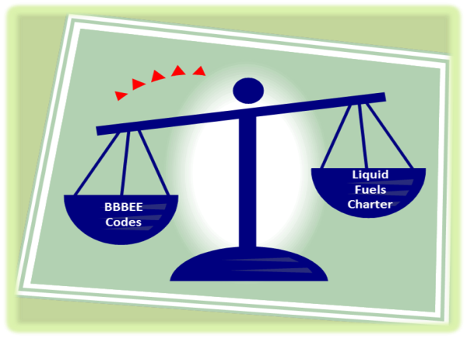
Conclusions & Impact analysis
Given that the bottom 3 performing elements in respect to both the LFC and BEE are:
Enterprise Development; Skills Development; Employment Equity and Preferential Procurement
The biggest lost opportunity over the past 10 years is technical skills transfer:
There was insufficient training to directly transfer the skills.
Due to less than desirable levels of promotion and employment of HDSAs, they were thus not afforded the opportunity for at least on the job training.
Black entrepreneurs were also not capacitated through enterprise development and trial /gradually improving procurement levels to afford them the experience.
The highest scoring areas are the quickest to remedy and involve a narrow base of beneficiaries, whereas the laggers generally take long to set up and implement – yet they have wider reach.
What was initially envisaged was fair ownership of assets, across the value chain by HDSA entrepreneurs who are significant players in the SA oil sector .
What was achieved was partial ownership of some assets by serial investors not very actively involved in key operations within the sector.
Support of the other and greater number of entrepreneurs, a– including retailers, and wholesalers is also the most wanting area.
Focus and key concern for oil companies has largely been BEE compliance:
Oil companies have only made progress regarding some LFC requirements only in the last 2 years i.e. 2008/09 – 2009/10

Slide 14
Recommendations
Ownership
DOE to:
Cause all companies that failed to make the 25% mark to be required to commit to concrete plans to address the gaps, within a set time frame.
A further disincentive by way of lower points in the new scorecards is required.
Consider increasing HDSA ownership requirements to ensure there is always an incentive to achieve more.
Women, broad-based and marginalized groupings including youth to be prioritized.
Develop the capacity of staff to assess the BEE deals and interrogate the related structures during the processing of license applications.
Play a pro-active role of ensuring that the best possible advantage is gained by HDSAs and women in particular, from all the divestments from downstream operations.
Consider a strategy similar to the equity equivalents scheme/ combined with appropriate incentives for locating the Upstream business of Oil Majors in South Africa and structuring BEE deals around them.
Facilitate amicable and mutually beneficial solutions for the deals under pressure and where there is impasse and set up mechanisms to help pick up such signs sooner and more systematically in future.
Management Control
Appropriate measurable stretch targets and incentives for women appointments to be built into the future scorecard.
Oil companies to focus more on executive and independent directors in future.
Supportive Culture
Reliable organizational climate checks should be regularly conducted. To be managed directly by CEO’s and reported on to the Boards.
The relevant supportive culture targets to be included in the performance contracts of senior managers as part of their Key Performance Indicators (KPIs).
Employment Equity
Oil Companies should ensure that there is equitable allocation of budget and job content responsibilities to black executives and managers.
Job- shadowing should be implemented as one of the means of fast-tracking HDSAs, particularly women.
Adequate and realistic incentives to be provided to the shadower to ensure success.
Oil companies to ensure balance amongst the black groups as well
DOE to seek guidance from the DOL on how to approach these instances and
To reach an understanding with the relevant companies on how the situation is being managed.
Government should enforce penalties on companies that are not advancing HDSA’s in Employment Equity, in a joint strategy / intervention programme with the Department of Labour.

Slide 15
Recommendations
Capacity Building
More practical and formally assessed exposure should be provided to black trainees.
Any future framework should adequately incentivize these interventions.
DOE to collaborate more with CHIETA and SAPIA to ensure that appropriate work related training programmes are developed and delivered, including fast-track type interventions.
Scarce skills occupations to be continuously communicated to institutions of higher learning for training and development.
There must be an effective partnership among DOL, DOE, DHE and the industry for development of programmes.
Procurement
Parent oil companies to allocate a set percentage of Crude oil Procurement from HDSA companies.
DOE to include minimum specified levels of crude procurement in the future procurement scorecard
HDSA’s to be granted longer term projects that would facilitate sustainability.
DOE to investigate why SASDA is not fully supported by Oil companies and address the gaps so identified.
Appropriate incentives for women-owned and small businesses
Access to Joint Infrastructure and Wholesaling
Facilitate the alignment of all legislation and tools to promote HDSA participation (through a coherent strategy) and ensure adequate enforcement. In particular:
Legislative Regulations
Resolve the conflicting regulatory objectives between Competition Authorities and the DoE/LFC .
Revise the regulatory barriers which disadvantage the HDSA wholesalers
Address inadvertent unfair competition by oil Majors, through vertical integration.
Better regulate importing by oil companies in order to allow HDSA’s to be competitive.
Set measurable stretch targets for wholesaling
with clear indication of requirements with respect to all types of wholesalers.
Consider rationalising number of licensed wholesalers
Set and enforce stricter conditions for continued operation by licensed importers and consequences of not following through on the intended purpose .
Enforce all legislation in this regard
Investigate allegations of use of unlicensed wholesalers and illegal activities by licensed wholesalers.
Ensure ffinalization and full implementation of NERSA’s Allocation Mechanism guidelines.
Enterprise Development
Help TransNet to more aggressively implement an empowerment framework for HDSAs.
Facilitate funding model for HDSA’s in importing crude through one or more of the DFIs.
Facilitate allocation of minimum capacity in the New Multi Products Pipeline to HDSAs.
Facilitate development of beginners’ guides into wholesaling clearly setting out critical success factors.
Facilitate creation of a benchmark for realistic HDSA wholesale license conditions.

Slide 16
Recommendations
Access to Finance
Local international banks to be lobbied to make appropriate introductions and facilitation with their international arms.
DFI’s to be assisted to develop tailor-made and relevant product packages for the sector.
International suppliers to be sensitized through their governments by means of trade agreements, to relax unnecessary demands; & be educated on the country’s capabilities & transformation objectives and modus operandi. Reporting, Monitoring and Evaluation
Reporting, Monitoring and Evaluation
Establishment of a reporting framework for the monitoring and measurement of compliance against set objectives and targets, resulting in uniform reporting by all the oil companies.
Web based monitoring and evaluation system that would allow companies to post their compliance reports annually.
A mechanism for more regular/ systematic reviews of the new framework.
Conducting of these compliance assessments (to the LFC charter) annually, to keep the companies on their toes and maintain the momentum created by this review.
Establishment of a vibrant platform on which to share information and strategies on the new empowerment framework.
Real incentives to be provided to companies that comply and punitive measures taken against those who will not.
To also consider the introduction of awards for oil companies that do well in their transformation programs, (i.e. compliance with LFC requirements).
Sector Code Recommendation
DOE to lead a process to develop a sector code in terms of the BBBEE framework.
To ensure measurability and yet preservation of the cornerstones of the previous charter that are not adequately catered for in the Generic BEE Codes.
OR reach an agreement with the DTI that would achieve a similar end result, taking into account envisaged upcoming changes to the BBBEE codes.
Sector code key enablers include: Categories/Indicators / sub – elements; Weighting points; Compliance targets; Bonus points/ Sub – minimums; Additional elements
Refining Capacity
Consider including local economic development requirements e.g.
minimum procurement levels towards local communities where refineries are located as part of a future scorecard.
HDSA companies should be assisted to optimally get involved in investing in the refinery upgrades and in providing services and related products there to as much as possible.
Retailing
Oil companies to introduce product lines from local small business suppliers – especially those surrounding refineries, e.g. bakery supplies, on a regional basis.
Oil companies to more determinedly consider ways of renegotiate the evergreen contracts.
DOE to consider related incentives.
Oil Companies and government to assist with the evaluation of the goodwill prices for existing service stations.
DOE needs to:
Improve the retail & site license management program & be vigilant during site change over process,
to ensure no inadvertent set – back to HDSA advancement.
Consider incentivizing the current Non-HDSA retailers to sell (shares) to HDSA’s, to avoid overtrading of the industry and expand opportunities for entry by HDSA’s.
Investigate and facilitate guidance on clauses to be discouraged from franchise agreements.
Investigate & strike an understanding with the oil companies on the over-representation of Indians among the black groups, & how this will be managed in future.
Set more stretch targets in a future framework to ensure this element does not regress further, but improves.
Continue discussions with DFIs and commercial banks, to encourage appropriate funding and support packages.

Slide 17
Thank You

